Slide 1

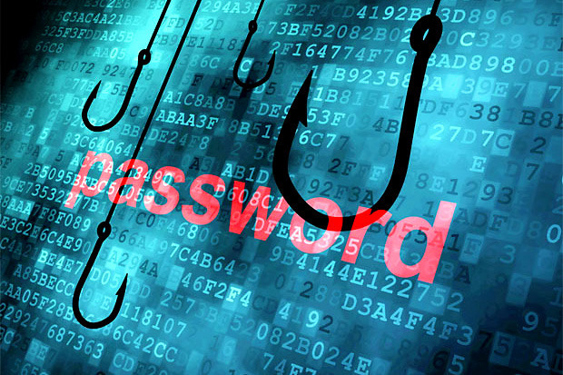

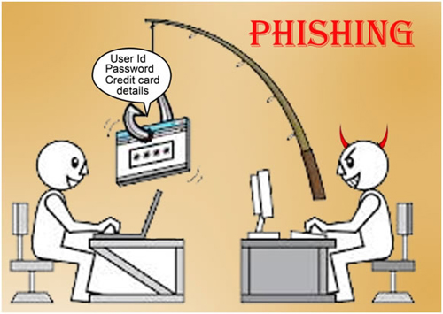
computer phishing

Slide 2
What is computer phishing
computer phishing is a scam used to get personal information like you bank account details or passwords.
A lot of the time computer phishing can be used to get IP addresses. Your IP can then be used by a hacker to get other information e.g. for example your home address.
computer phishing will normally be in the form of a website and need the user to enter their bank account information or other information.
They will do it a lot of the time by pretending to be your bank and try to steel your delails or say you have won money.

Slide 3
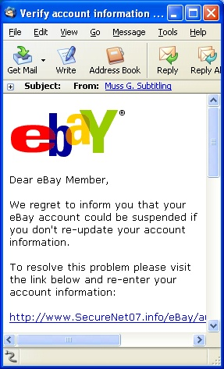
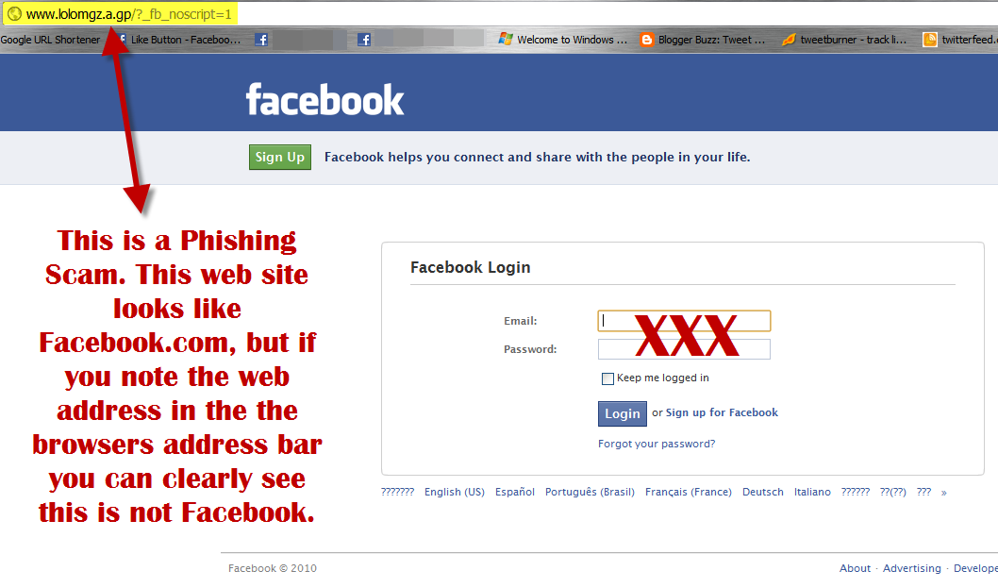
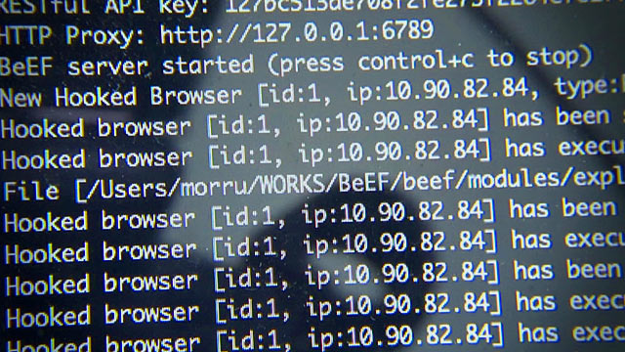
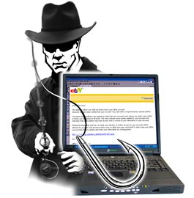
How to protect your self from computer phishing
Be wary of emails asking for confidential information
Don't get pressured into providing sensitive information
Watch out for generic-looking requests for information
Make sure you maintain effective software to combat phishing.

